Slide 1
Supporting Business in The Hills
Thursday, 21 September 2023
Mayor Dr Peter Gangemi

Slide 2
Today’s Presentation
Council initiatives aimed at supporting businesses
Council Policies
Economic Development Team

Slide 3
PART 1
Council Policies

Slide 4
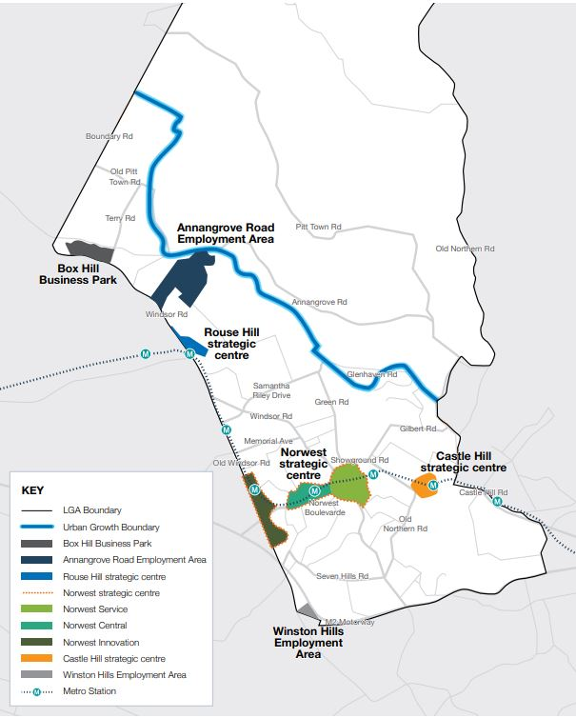
Growth in The Hills
Population
200,000 in 2023 → 290,000 by 2036
Local Businesses
23,000 in 2023 → 38,000 by 2041
Local Jobs
84,000 in 2023 → 140,000 by 2041

Slide 5
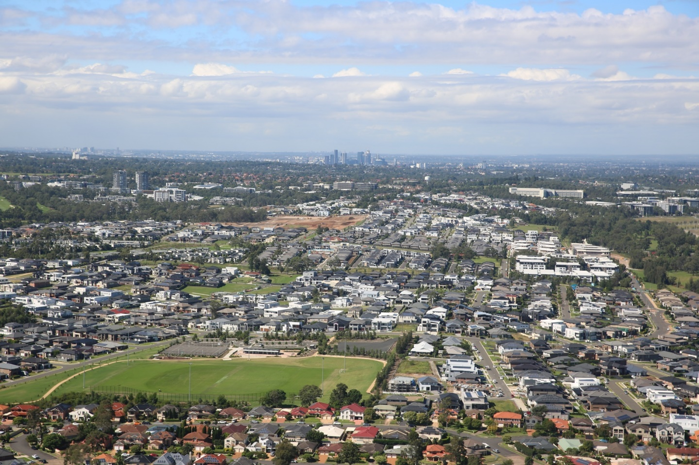
Zoning land for business
One of our most crucial roles as a Council is to ensure we have enough land zoned for employment.
We value the zoning of employment areas
We have enough land zoned for employment to meet our 2036 job targets

Slide 6
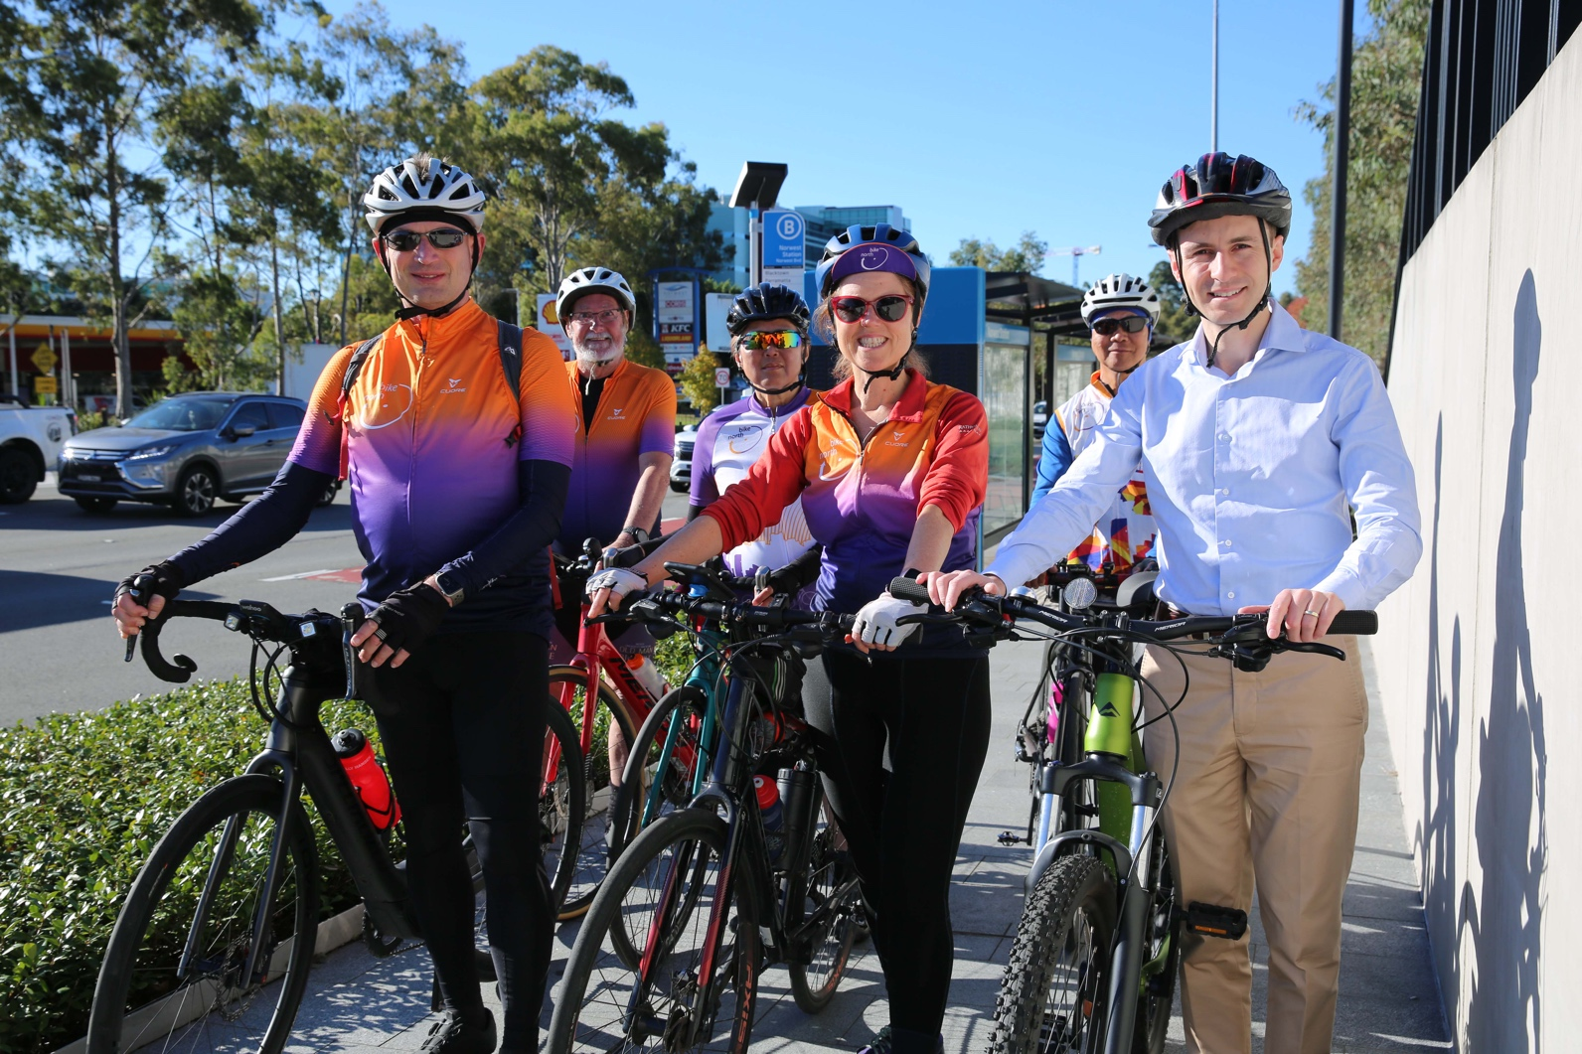
Connectivity
In and around employment areas, Council is improving
Roads
Intersections
Footpaths
Cycleways

Slide 7
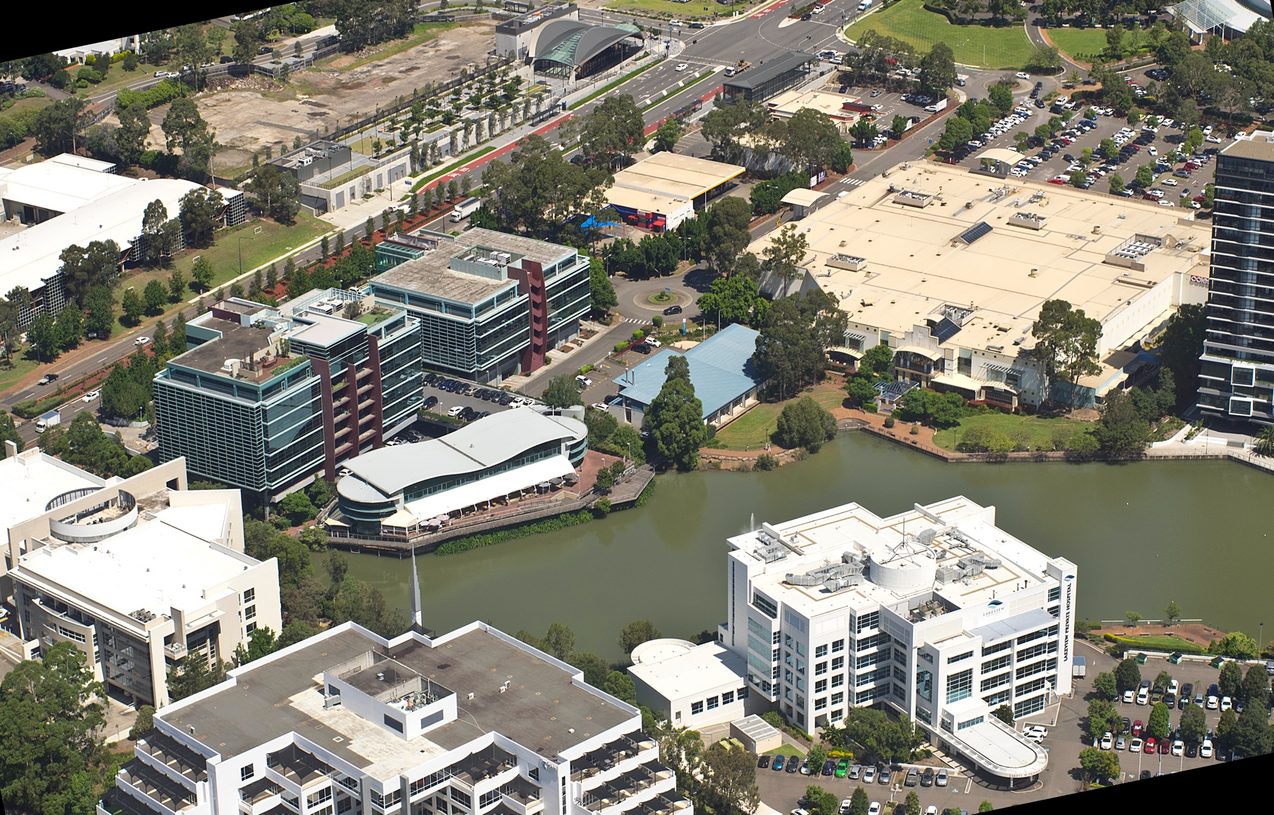
Great Amenities
Employment areas must also be enjoyable, vibrant and attractive places to work with quality parks and placemaking

Slide 8
Economic Growth Plan
Recently exhibited document, providing the direction for economic development, jobs and investment for the next 20 years
More residents working locally
Less service based, more jobs to suit our skilled workforce
Strategic Direction and Action Plans

Slide 9
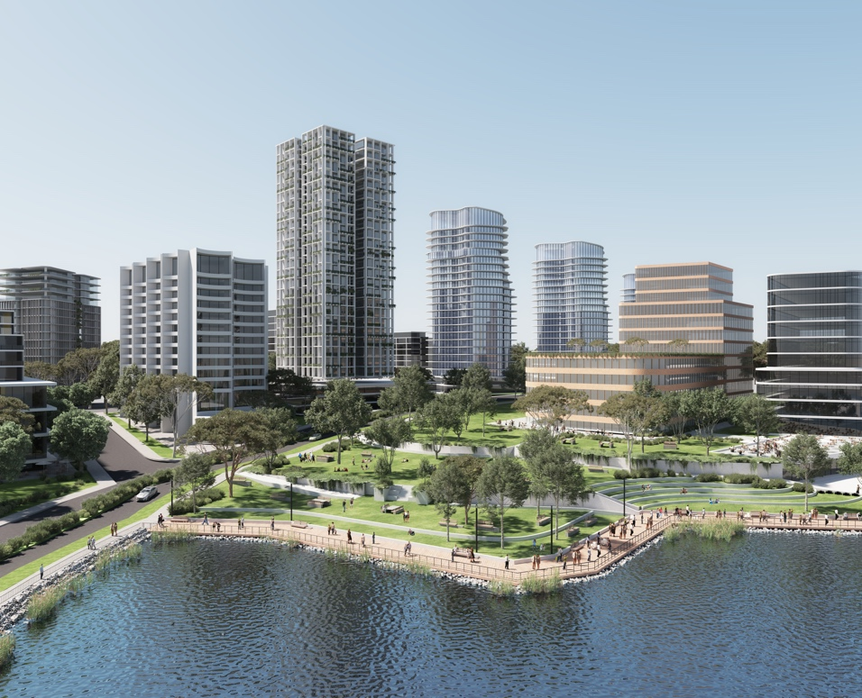
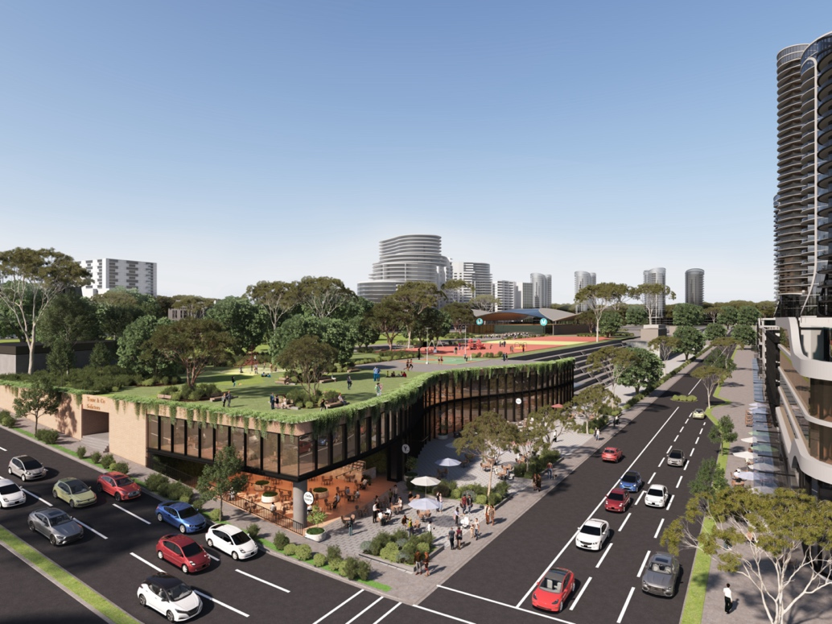
Our 20-year vision
Arthur Whitling Park
Extension
Proposed new park
along Norwest Lake
Proposed Eat Street
in Castle Hill

Slide 10
PART 2
Economic Development Team

Slide 11
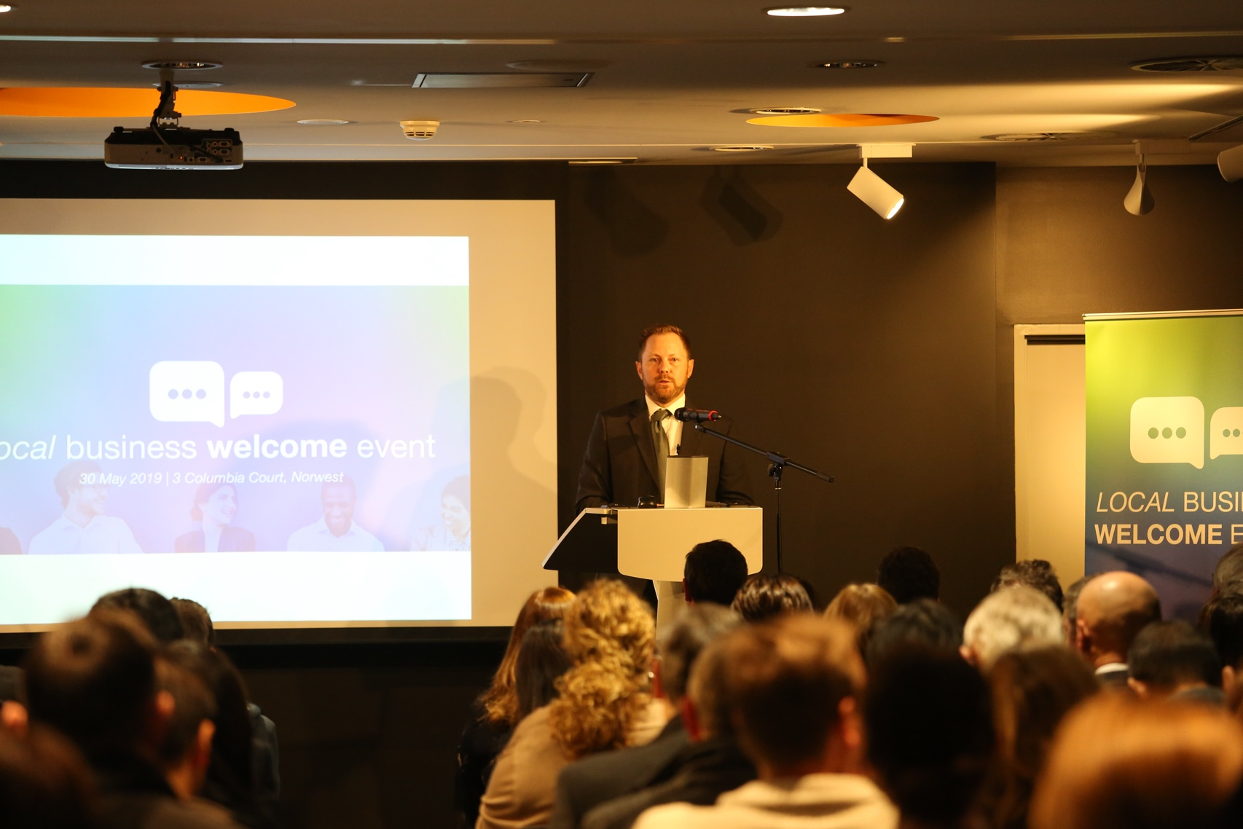
Meet our Economic
Development Team
The Economic Development Team support small businesses in The Hills
The team are available to meet with you to provide business support

Slide 12
Connecting
The Economic Development Team can connect you with key stakeholders
Service NSW, Sydney Hills Business Chamber, BNI, potential suitable businesses or community groups

Slide 13
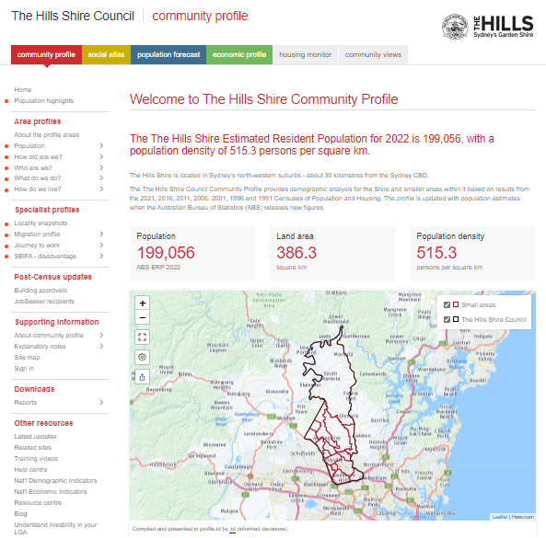
Demographic Database
Community Profile, Social Atlas, Population Forecast and Economic Profile
Detailed information on output, businesses, workers broken down by sector
Enables you to make better business decisions

Slide 14
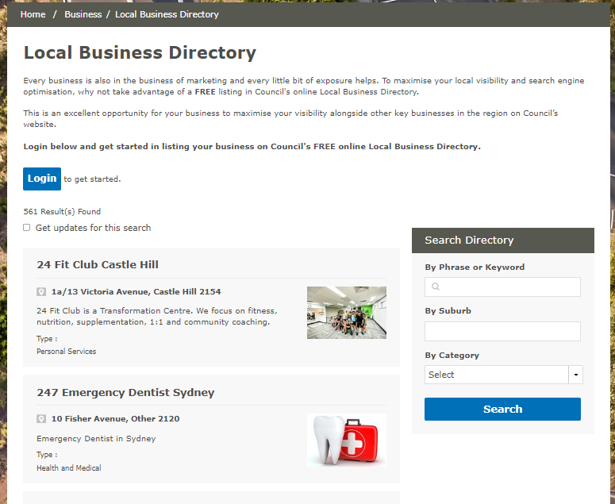
Local Business Directory
Council can list your business on our local business directory
Helps others find your business
Helps your Search Engine Optimisation

Slide 15
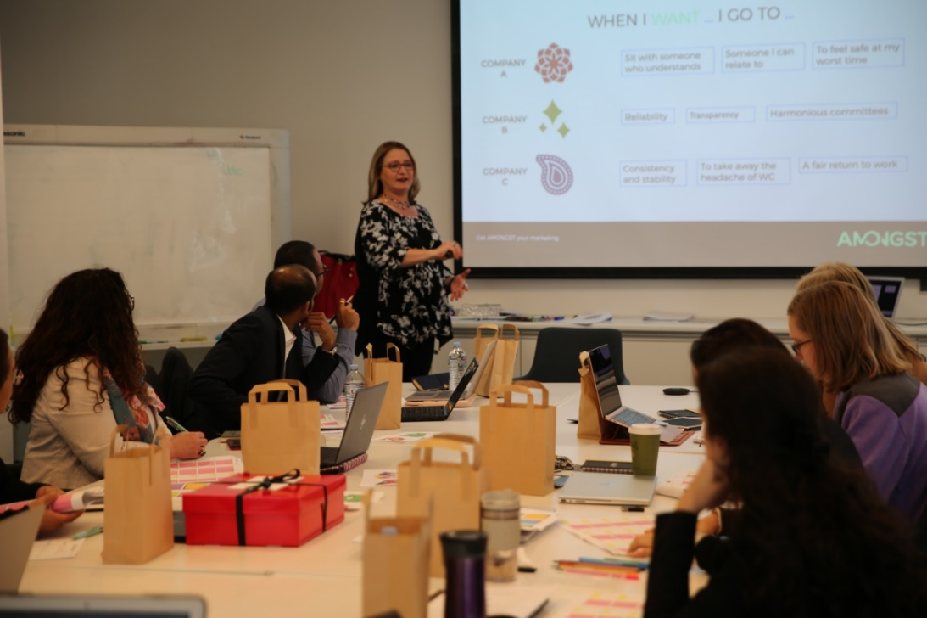
Workshops
Council runs workshops year round to assist small business owners
How to start a business on October 18; and
Media Channels and the Battle for Conversion on October 20.
Book: www.thehills.nsw.gov.au

Slide 16
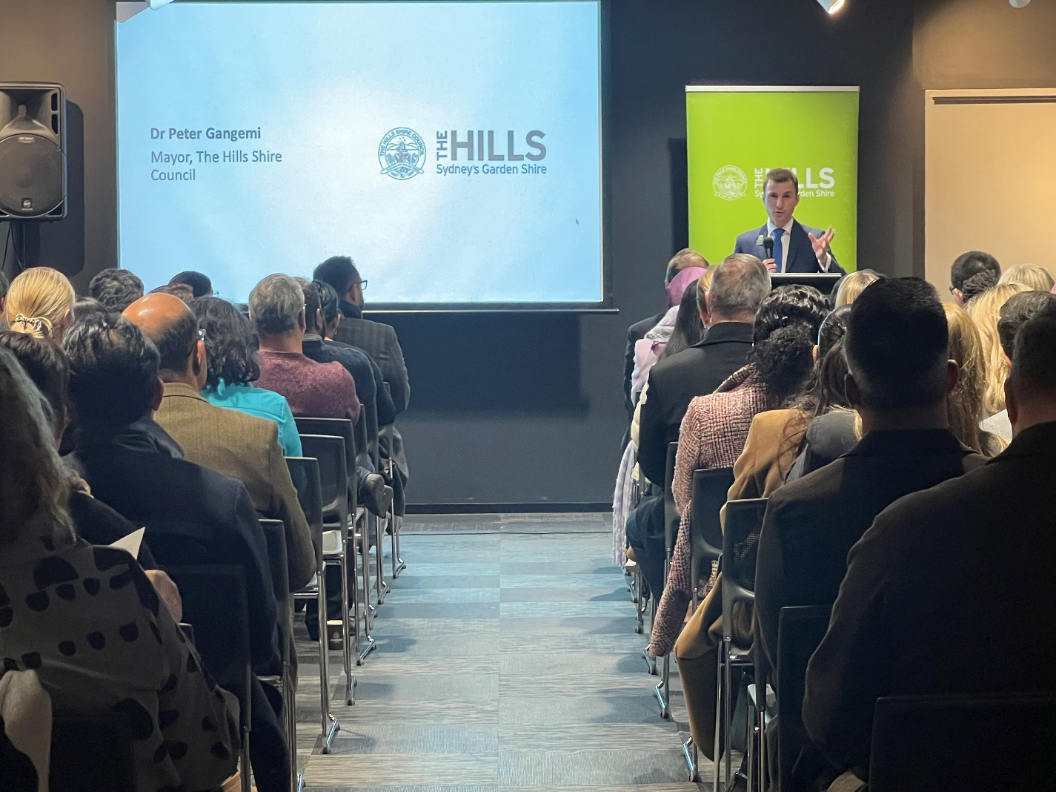
New Business Connector
Council runs a New Business Connector each year
Information for new business owners
Details on how Council can support you
Meet the Economic Development Team
Meet key community business contacts such as the Sydney Hills Business Chamber, BNI, Service NSW agencies and other new business owners

Slide 17
Partnerships
We are an alliance partner of The Sydney Hills Business Chamber.
Council is proud to support the activities of the SHBC.
Staff and Councillors regularly connect with small business owners in the chamber

Slide 18
WEXPO
October 11 at Castle Grand, free entry
A one day professional development event for small business in The Hills
The day features exhibits, chamber breakfast, jobs forum plus workshops
Workshops in marketing, finance, legal, business success and starting a business
Register at www.wexpo.com.au

Slide 19
Summary
Council initiatives aimed at supporting businesses
Council Policies
Economic Development Team

Slide 20
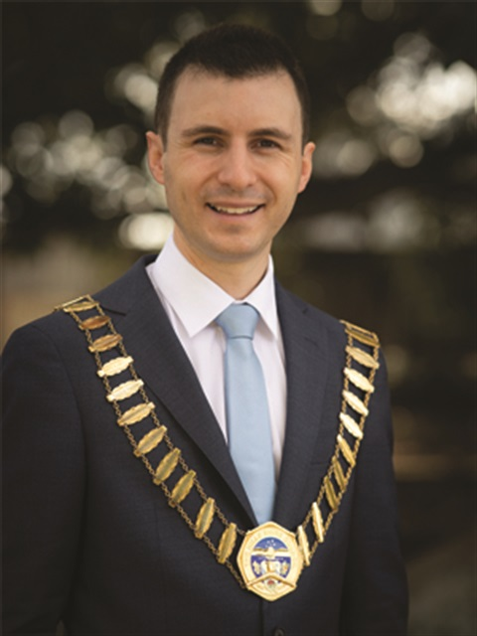
Thank you
Thank you for listening!
Feel free to contact me
mayor.gangemi@thehills.nsw.gov.au
0419 429 095
LinkedIn, Facebook and Instagram

